Slide 1
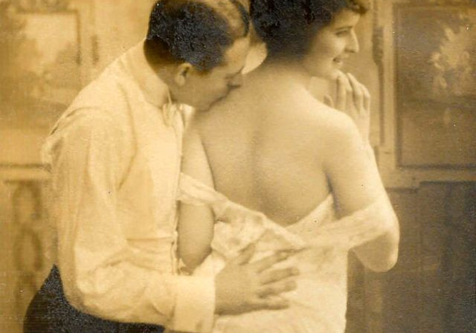
Sexual and Romantic Relationships
Michael McGee, PhD

Slide 2

The importance of relationships
Humans have a need to belong, a near universal desire for social ties (Baumeister & Leary, 1995)
Relationships are important for our physical and psychological well-being
We can fulfill our relational needs in many ways

Slide 3

Singlehood and casual relationships
More adults are living single today than ever before
Perceptions of singles are largely negative
  Negative stereotypes and discrimination are common
Singles may have a wide range of sexual relationships

Slide 4
Sexuality among singles
Some singles may be celibate, and some may be asexual
Others may pursue casual relationships, including hookups and friends with benefits (FWBs)
  Hookups are generally one-time encounters
    Both men and women have them, but men report enjoying them more

Slide 5
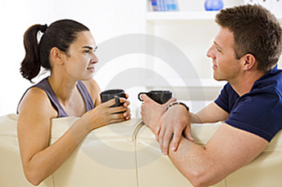
Sexuality among singles
FWBs can mean many different things, but usually refer to an ongoing sexual relationship with a non-romantic partner
    Men and women have different motivations and expectations for these relationships
    Sometimes evolve into romances
Singles may also be involved in more committed relationships
  Serial monogamists enter and exit long-term, monogamous relationships repeatedly

Slide 6

Sexuality among singles
Regardless of relationship state, singles are generally less sexually satisfied than married couples
Single women also reach orgasm less consistently (Laumann et al., 1994)

Slide 7

Why do men and women value different characteristics?
Socio-cultural theory
  Biological and evolved factors may play some role, but psychological sex differences are largely a product of the social structure
  In societies with more gender equality, sex differences in mate preferences are more similar (Zentner & Mitura, 2013)
  Conley (2011): men are not always more interested in casual sex than women

Slide 8
Socio-cultural theory
  Alexander & Fisher (2003): women reported different sexual histories when hooked up to a lie detector
  Critiques
    Suggests a mind-body dualism in arguing that psychological sex differences are not subject to evolutionary pressures
    Psychological sex differences do have at least some biological basis (e.g., consider women with congenital adrenal hyperplasia)

Slide 9
Complete the sentence…
A romantic relationship is good when….
A romantic relationship is in trouble when….
It’s time to get out of a romantic relationship when….

Slide 10

The nature of love
Love is a special set of cognitions, emotions, and behaviors observed in an intimate relationship
There are two main types of love studied by psychologists: passionate & companionate

Slide 11
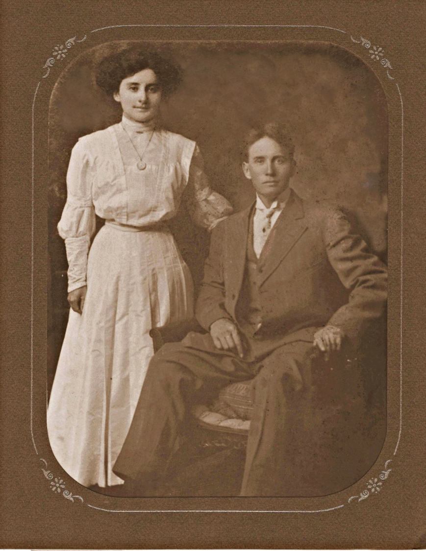

Slide 12
Passionate love
All-consuming physical and psychological state
Feelings are very intense early on and decrease over time
Sets in before partner is known very well
Usually temporary

Slide 13
Companionate love
Much deeper and less intense state characterized by intimacy and commitment
Based upon full knowledge of other person’s character
Develops gradually over time and tends to be more enduring
Passionate love often develops into companionate love

Slide 14
Theories of love
Sternberg’s (1986) Triangular Theory
  Three components of love
    Passion – motivational component
    Intimacy – emotional component
    Commitment – cognitive component
  Passion builds up quickly, then declines
  For relationship to last, intimacy and commitment must compensate

Slide 15
Sternberg’s Triangular Theory
  These components can be combined to form 8 different types of love
  Ideally, we want all three components present simultaneously (consummate love)
  Your love triangle may be different from your partner’s
Intimacy
IDEAL
Passion
Commitment

Slide 16
Sternberg’s 8 varieties of love
Type of Love | Passion? | Intimacy? | Commitment? | Example
Nonlove | No | No | No | Acquaintances
Liking | No | Yes | No | Close friends
Infatuation | Yes | No | No | Crushes
Empty Love | No | No | Yes | Some arranged marriages
Fatuous Love | Yes | No | Yes | Long-distance relationships
Romantic Love | Yes | Yes | No | Friends with benefits
Companionate Love | No | Yes | Yes | Long-term, happy couples
Consummate Love | Yes | Yes | Yes | “Epic” romances

Slide 17
Theories of love
B. Lee’s (1977) Styles of Loving
  Emphasizes how people approach love
    1. Romantic – “hopeless romantic,” love at first sight
    2. Altruistic – selflessness and unconditional love
    3. Pragmatic – practical and businesslike, the “shopping list” love style
    4. Game-playing – casual and uncommitted

Slide 18
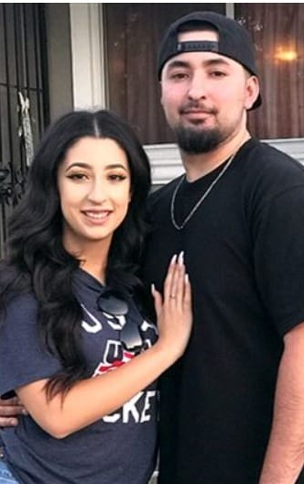
Lee’s Styles of Loving
    5. Companionate – peaceful and affectionate, friends first
    6. Possessive – intensive, obsessive love relationships
  No one style is better than another; relationship success depends upon matching of styles
  There are sex differences in some love styles (e.g., game-playing, pragmatic), consistent with evolutionary predictions

Slide 19
The nature of commitment
Often overlaps with love, but is a distinct construct
  Viewed as a cognition about a relationship – an intention to remain with one’s partner
The Investment Model of commitment (Rusbult, 1980)
  Commitment is driven by three factors: satisfaction, alternatives, and investments

Slide 20
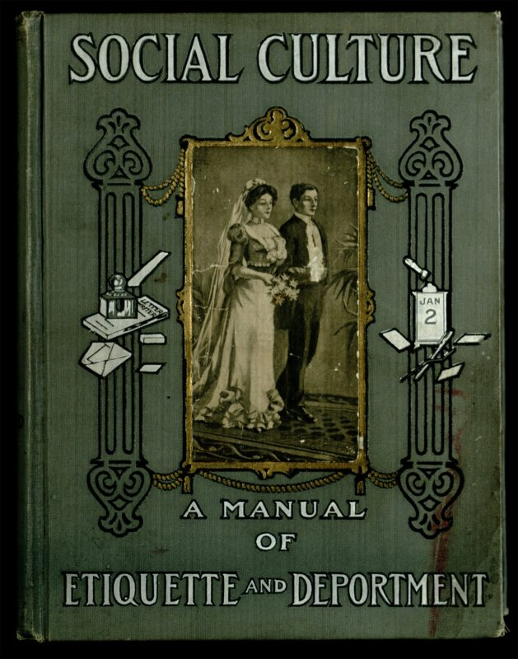
The Investment Model
1. Satisfaction: one’s subjective evaluation of the relationship
  Are we getting what we think we deserve?
2. Alternatives: how desirable are other partners and relationship states?
  Could you get a better deal elsewhere?
3. Investments: everything you have put into the relationship
  Both tangible and intangible

Slide 21
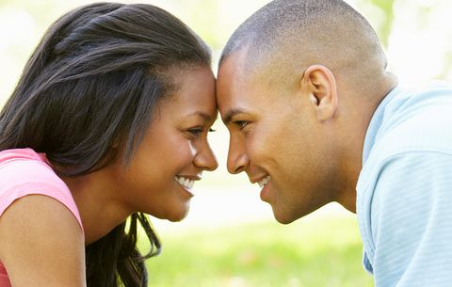
The Investment Model
Commitment is strongest when we are highly satisfied, have invested much, and perceive poor quality alternatives
Can help explain why people stay in both good and bad relationships

Slide 22

Varieties of loving and committed relationships
A. Heterosexual vs. same-sex
  Some cultures extend marriage rights to same-sex couples
  Same-sex couples tend to establish greater equality, but are more likely to break up (perhaps due to inequality in marriage rights)
B. Monogamous vs. non-monogamous
  Consensual nonmonogamy: an explicit agreement to have sexual or romantic relationships with others

Slide 23
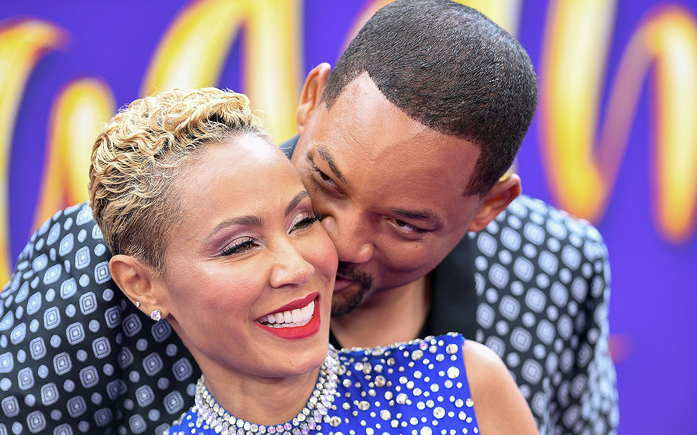
Varieties of loving and committed relationships
  Types of consensual nonmonogamy
    Open relationships: relationship “home base,” but ability to pursue outside partners
    Swinging: temporary swapping of marital partners
    Polygamy: marriage with multiple spouses
      Polygyny vs. polyandry
    Polyamory: multiple sexual and/or romantic partners simultaneously, with or without marriage
  The Coolidge Effect helps explain the appeal of consensually nonmonogamous relationships: as we become more familiar with a sexual stimulus, our arousal to it habituates
  Many beliefs about nonmonogamy are unfounded
    e.g., idea that nonmonogamy is always unsafe and monogamy is always safe

Slide 24

Varieties of loving and committed relationships
C. Married vs. cohabiting
  Marriage rate is in decline, cohabitation is increasing
  Cohabiting couples tend to have greater equality and less traditional gender role adherence, but fewer legal rights and protections
  Both marriage and cohabitation associated with better health than being single (Musick & Bumpass, 2012)

Slide 25
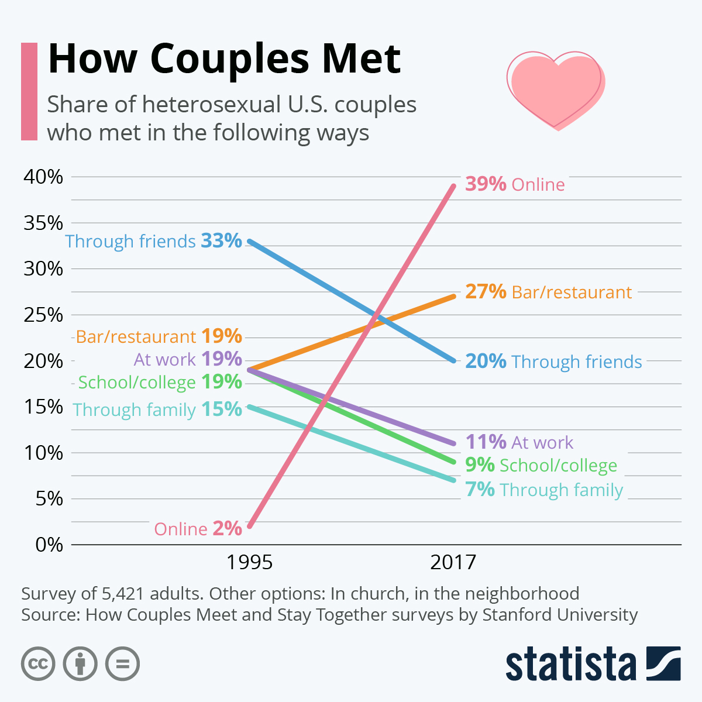

Slide 26
Relationship Assessment

Slide 27

Characteristics of good relationships
A. Positive communication
  Gottman (1994): biggest predictor of early divorce was ratio of positive to negative comments that occurred in a videotaped discussion
  Defensive behaviors such as stonewalling (i.e., indifference to partner’s concerns) also predicted early breakup

Slide 28
Characteristics of good relationships
B. Healthy sexuality
  Couples who communicate more in bed are more sexually satisfied (Babin, 2013)
  Both verbal and nonverbal communication are important
  Sexual communal strength is part of a healthy relationship
    i.e., willingness to satisfy partner’s needs even when they do not align with your own

Slide 29
Characteristics of good relationships
C. Self-expansion
  Humans have a fundamental need to “expand” the self over time (Aron & Aron, 1986)
  Relationships are a form of expansion, but we must continue to engage in novel and exciting activities with our partners to keep meeting those expansion needs

Slide 30

The dark side of relationships
The divorce rate is a high as it has ever been
Many factors contribute to breakup and divorce
A. Social disapproval
  Perceived disapproval is linked to a greater likelihood of breakup and poor health (Lehmiller & Agnew, 2007; Lehmiller, 2012)

Slide 31
The dark side of relationships
B. Insecurity and jealousy
  Feelings may stem from many sources
  Attachment styles: patterns of approaching and developing relationships
    Secure: easy time getting close, no fear of abandonment
    Anxious: partner does not get as close as desired, fear that partner will leave (greater insecurity and jealousy)
    Avoidant: uncomfortable with intimacy and dependence on others

Slide 32
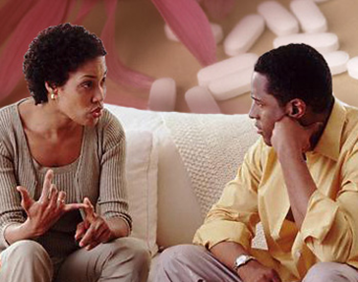
Jealousy
  Sex differences in the experience of jealousy
    Men are more concerned about sexual infidelity and women about emotional infidelity (Buss et al., 1992)
      Theorized to be a result of men’s paternity uncertainty, but other explanations possible

Slide 33
The dark side of relationships
C. Cheating
  Nonconsensual nonmonogamy: when a monogamy agreement is violated
  Estimates of cheating prevalence vary depending upon how infidelity is defined, type of sample, etc.
    People’s own personal definitions of cheating vary considerably
  Cheating often precipitates breakup and divorce

Slide 34
Cheating
  Cheating is a psychosocial phenomenon
  Is monogamy a realistic expectation? Would people be happier in nonmonogamous relationships?
    Some argue that nonmonogamy is our “natural” state, but it is likely that different relationship states work better for different people

Slide 35
Coping with breakup
Active coping strategies tend to be most effective
i.e., dealing with the issues head-on by talking about them
Viewing breakup as an opportunity for personal growth may result in better adjustment

Slide 36
Coping with breakup
Common emotions after a loss
Loneliness and grief
Sense of having been rejected
Guilt
Anger
Crying is a healthy release
“Rebound” relationships – not a good idea
https://www.youtube.com/watch?v=n8_QERLOu40&feature=youtu.be&app=desktop

Slide 37
Questions and Comments

